Slide 1
PHASE 3 PROJECT
STUDENT NAME; CHEBET SHARON
INSTRUCTOR NAME; MARYANNE MWIKALI
STUDENT PACE; DATA SCIENCE PART TIME

Slide 2
BUSINESS UNDERSTANDING
BUSINESS PROBLEM
SyriaTel is having customer churn and that is directly impacting revenue and profit. For that, the company must know what causes customer to be dissatisfaction. SyriaTel can’t develop retention plans without understanding churn and high-risk customers, leading to continued customer loss and a decline in market share.
OBJECTIVES
Identify key factors influencing customer churn.
Predict customer churn.
Provide actionable insights to enable SyriaTel to implement targeted interventions.
STAKEHOLDERS
SyriaTel Telecommunications Company.
Marketing team
Customer care service team

Slide 3
DATA PREPARATION
Data sourced from Kaggle – SyriaTel customer churn
Data was cleaned by removing unnecessary columns, it was noted that there was no missing or duplicated date

Slide 4
Exploratory data analysis
From EDA
Account length
Both churned and non-churned customers show similar distributions for account length, with no major differences.
Account length might not be a significant factor in predicting churn.
-Number of Voicemail Messages vs churn
The majority of customers have a low number of voicemail messages.
There are many outliers at the upper end, suggesting some customers have significantly higher voicemail messages than the rest.
.
-Total Minutes vs churn
Non-churn customers: Total minutes appear to be centered around a slightly lower range.
Churned customers: They have a wider range of total minutes, with a higher median.
Customers with higher total usage might be more likely to churn, potentially due to high costs.
-Total Calls vs churn
Both churned and non-churned customers show similar distributions for total calls, with no major differences.
Total calls might not be a significant factor in predicting churn.
-Total Charge vs churn
Non-churn customers: Charges are lower and have a narrower spread.
Churned customers: Charges are higher and exhibit a wider spread.
Higher total charges are associated with churn, suggesting dissatisfaction with billing or costs

Slide 5
modelling
Logistic Regression was used for binary classification.
Selected for its interpretability and simplicity.
Random Forest Classifier was used for comparison and had better predictive value

Slide 6
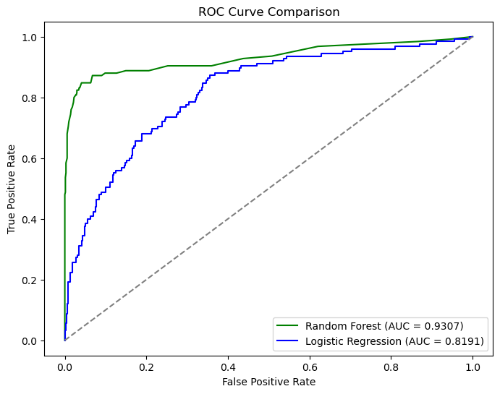

Slide 7
EVALUATION
Metrics used: Accuracy, Precision, Recall, ROC-AUC.
• Model had high recall, effectively identified churn cases.

Slide 8
RECOMMENDATION
-Random Forest is the better model if your goal is to achieve a more robust performance for detecting churn while handling class imbalance.
Target high-risk customers with retention plans.
• Improve customer service experience.
• monitor daytime users and give incentives

